Slide 2
VeriStand Step Types for TestStand
Build Process Documentation
Andy Church
January 2017

Slide 3
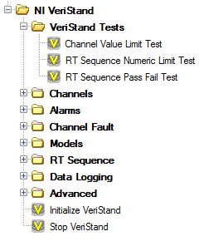
Contents
Accessing the build servers
Setting up the build servers
Software installation
Environment variables
How the build works
Jenkins configuration
Jenkins Job configuration
Source code / batch files
Adding a version to server

Slide 4
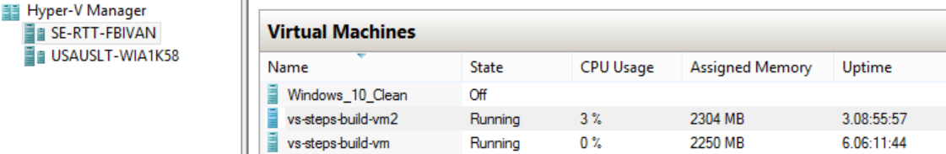
Accessing the Build Servers
Build Servers are Hyper-V VMs hosted on se-rtt-fbivan
se-rtt-fbivan (physical machine hosting build server VMs)
username: se-rtt-fbivan\administrator
password: Labvi3w
vs-steps-build-vm (SP-versions) vs-steps-build-vm2 (non-SP versions)
username: vs-steps-build-vm\admin username: vs-steps-build-vm2\admin
password: Labview password: Labview

Slide 5
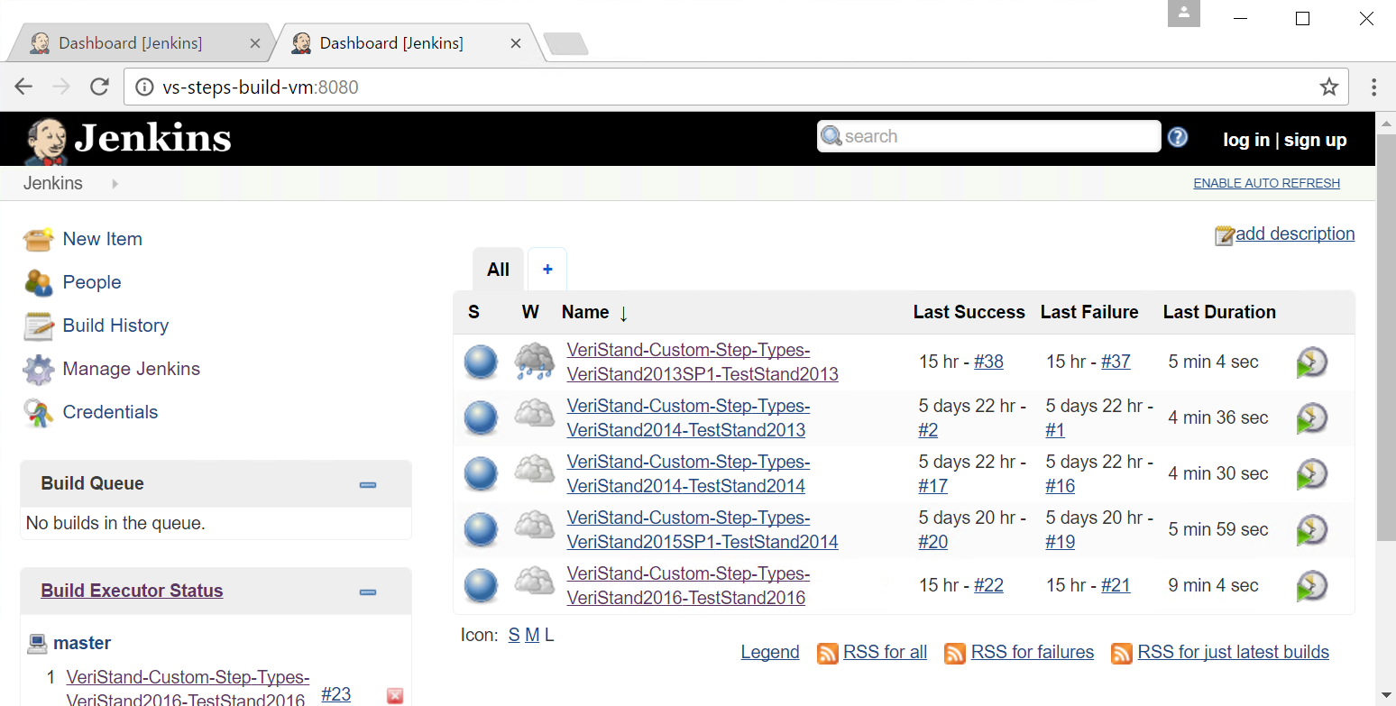
vs-steps-build-vm

Slide 6
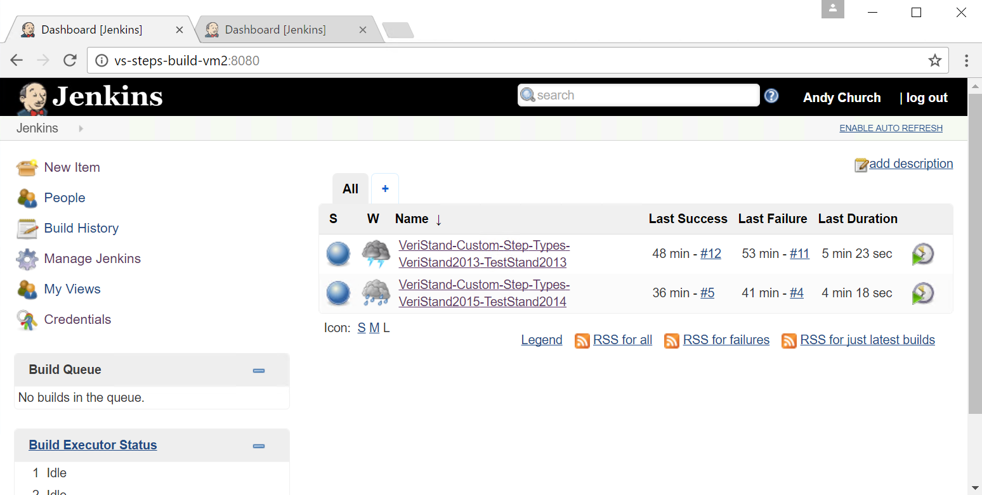
vs-steps-build-vm2

Slide 7
Credentials

Slide 8
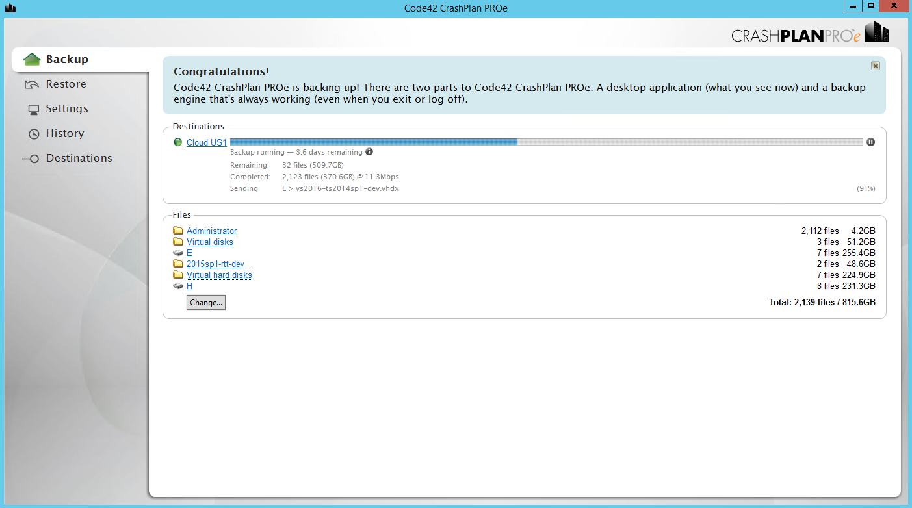
Build server backup
Currently build servers are only backed up through CrashPlan account

Slide 9
Software Installation (including approximate install order)
vs-steps-build-vm:
LabVIEW 2013 SP1, 2014 SP1, 2015 SP1, 2016
TestStand 2013 SP1, 2014 SP1, 2016
VeriStand 2013 SP1, 2014, 2015 SP1, 2016
SourceTree
Visual Studio 2015 Professional
Visual Studio Deployment Project Hotfix
For all LV versions install using VIPM:
OpenG Toolkit
VIPM API
JKI State Machine Toolkit

Slide 10
Software Installation (including approximate install order)
vs-steps-build-vm2:
LabVIEW 2013 SP1, 2014 SP1, 2015 SP1, 2016
TestStand 2013 SP1, 2014 SP1, 2016
VeriStand 2013, 2015
SourceTree
Visual Studio 2015 Professional
Visual Studio Deployment Project Hotfix
For all LV versions install using VIPM:
OpenG Toolkit
VIPM API
JKI State Machine Toolkit

Slide 11
CER Git Repo Location

Slide 12

Environment Variables
Persistent variables within the Windows environment
Variables in use should be saved to .txt on desktop
This build process uses environment variables in three ways
Set up variables to use Visual Studio’s command line build tools
Set up variables to serve as replacement Jenkins variables while debugging build process
Use variables to make Jenkins build step commands simpler

Slide 13
Environment variables on vs-steps-build-vm
%jenkinsautobuild%=C:\Users\Public\Documents\Git-Source\Jenkins-Autobuild
%workspaceroot%=C:\Program Files (x86)\Jenkins\workspace
%gitrepo%=C:\Users\Public\Documents\Git-Source
%customstepsgitroot%=C:\Users\Public\Documents\Git-Source\VeriStand-Custom-Steps-For-TestStand

Slide 14
Contents
Accessing the build servers
Setting up the build servers
Software installation
Environment variables
How the build works
Jenkins configuration
Jenkins Job configuration
Source code / batch files
Adding a version to server

Slide 15
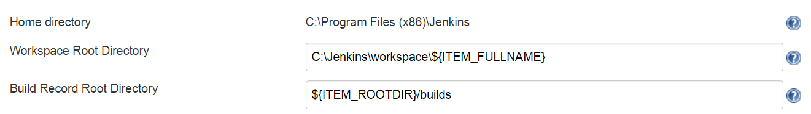
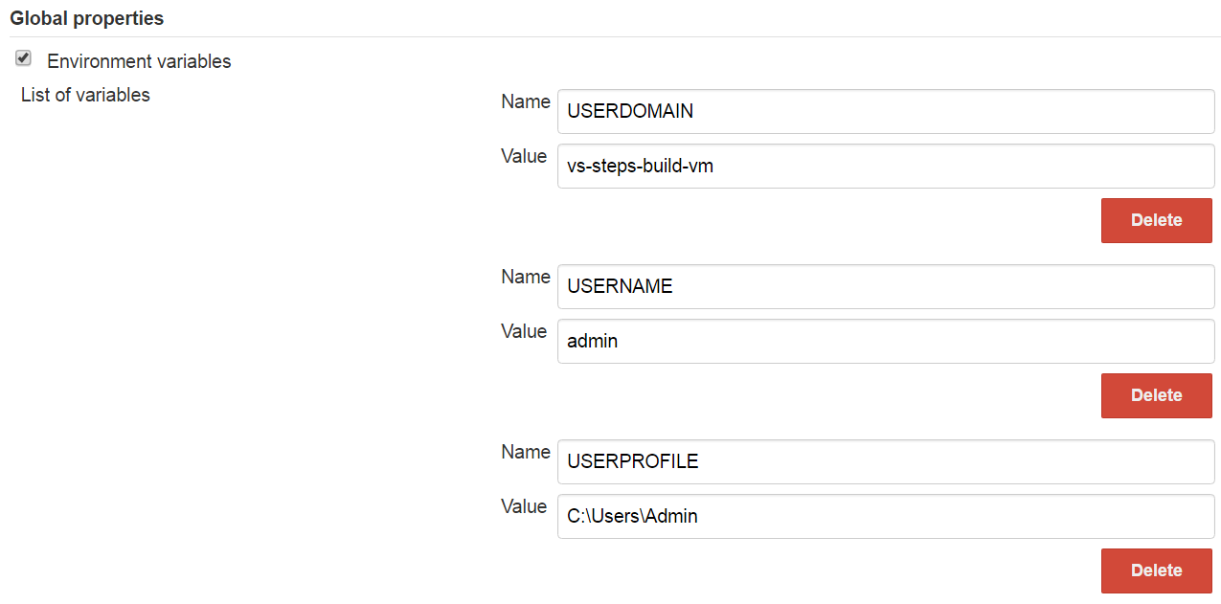
Jenkins configuration

Slide 16
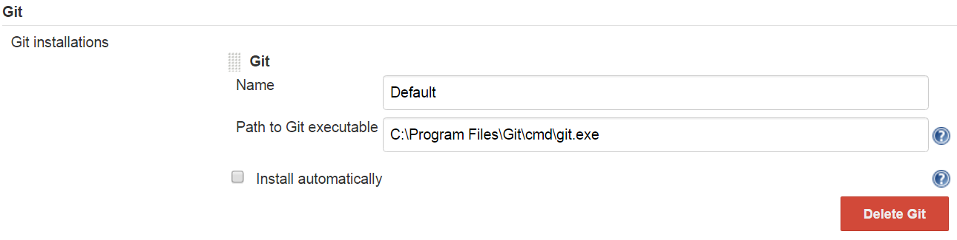
Jenkins configuration

Slide 17
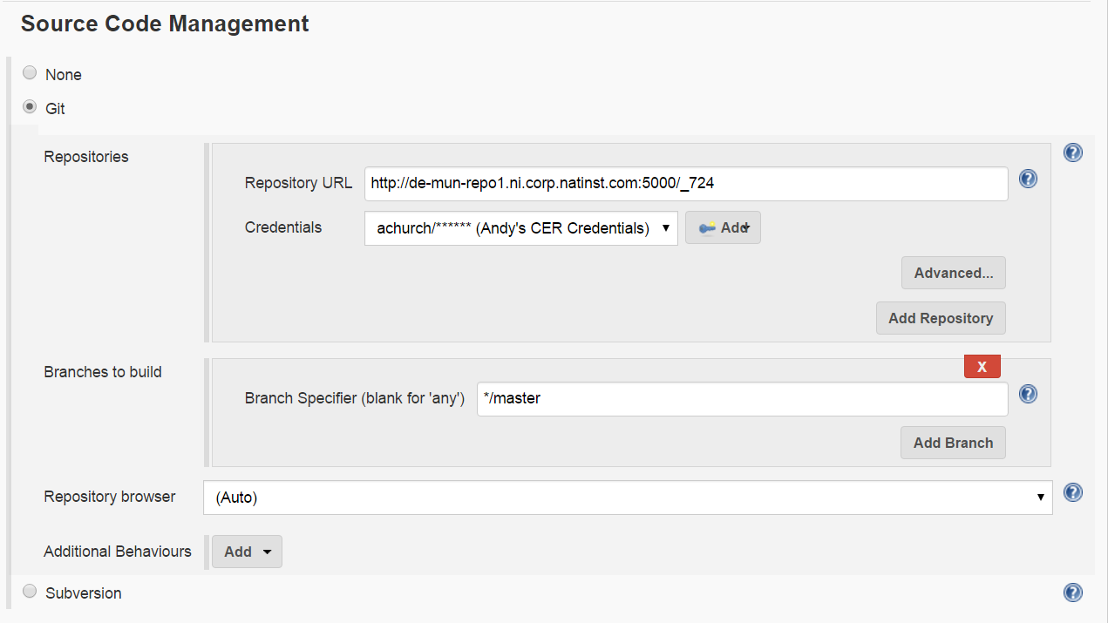
Jenkins job configuration: SCM

Slide 18
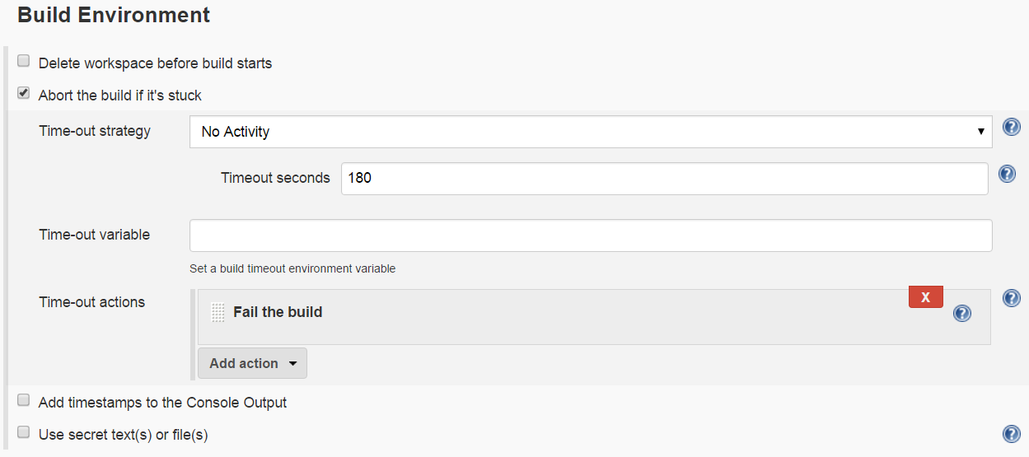
Jenkins job configuration: Environment

Slide 19
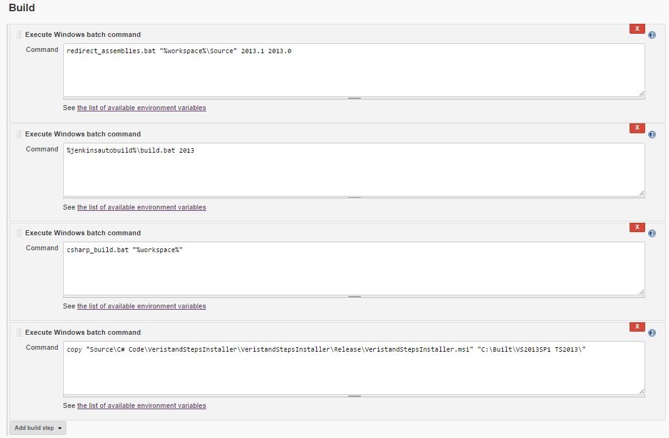
Jenkins job configuration: Build Steps

Slide 20
Contents
Accessing the build servers
Setting up the build servers
Software installation
Environment variables
How the build works
Jenkins configuration
Jenkins Job configuration
Source code / batch files
Adding a version to server

Slide 21
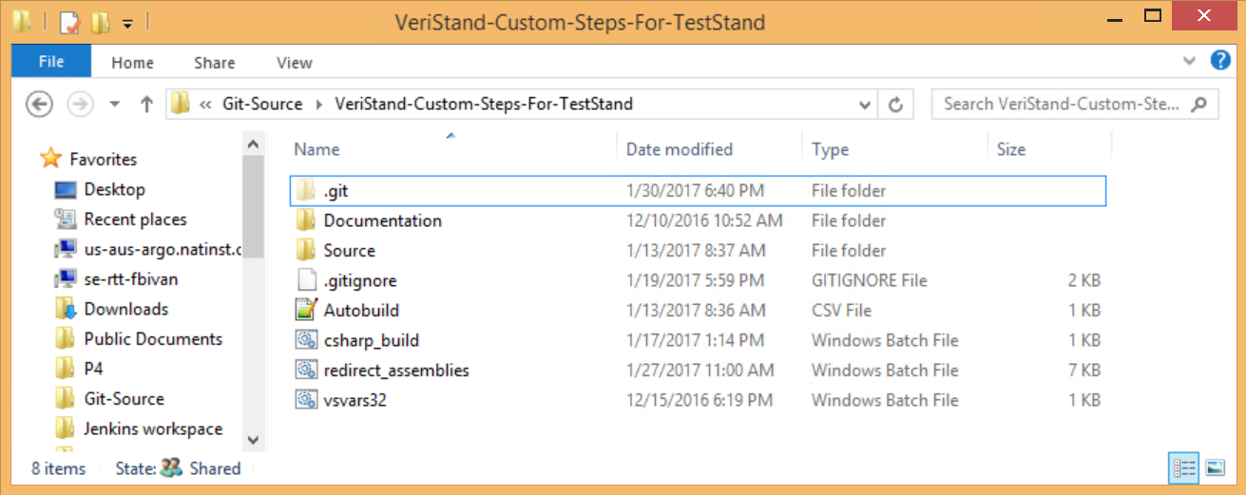
Job build steps: Version redirection

Slide 22
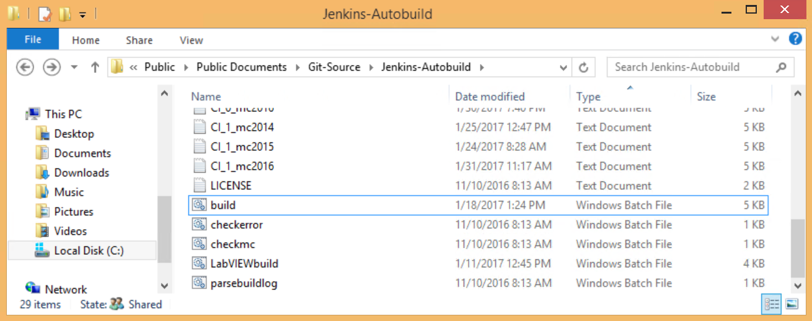
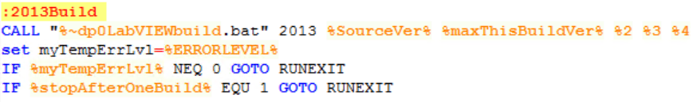
Job build steps: LabVIEW build

Slide 23
Job build steps: C# build

Slide 24
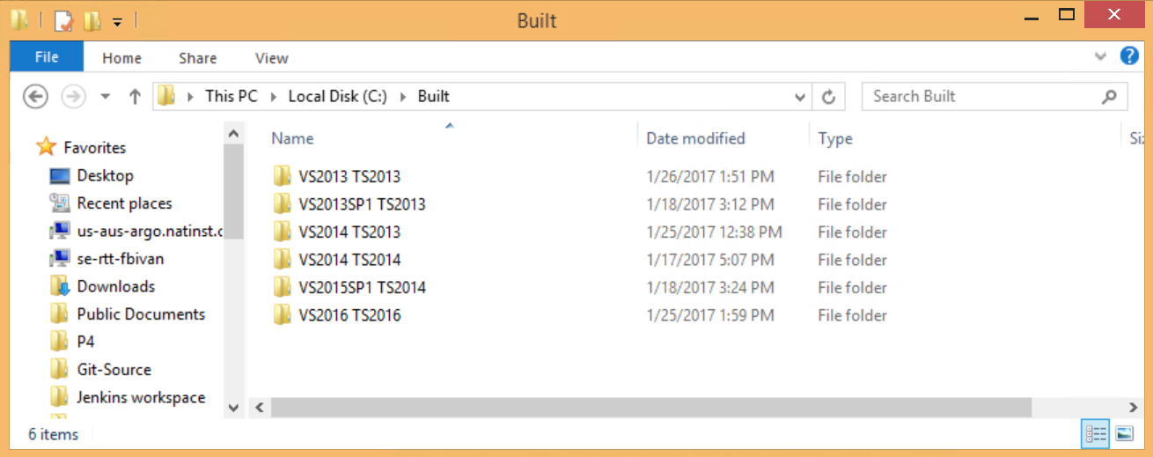
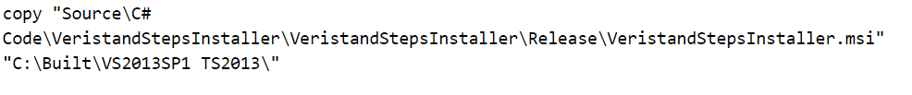
Job build steps: Move Installer to built directory
Copy Installer to built folder

Slide 25
Contents
Accessing the build servers
Setting up the build servers
Software installation
Environment variables
How the build works
Jenkins configuration
Jenkins Job configuration
Source code / batch files
Adding a version to server

Slide 26
Steps to add build for new VS version
Install new version of LabVIEW (if required) followed by new version of VeriStand
Place LabVIEW.exe.config file in LabVIEW directory (if installing new LV version)
Update build.bat to include higher LabVIEW version (if installing new LV version)
Update redirect_assemblies.bat to include path/version variables for new VeriStand version
Create new Jenkins Job by copying a previous Job
Update version numbers passed to batch files in Job Configuration
Build

